Slide 1
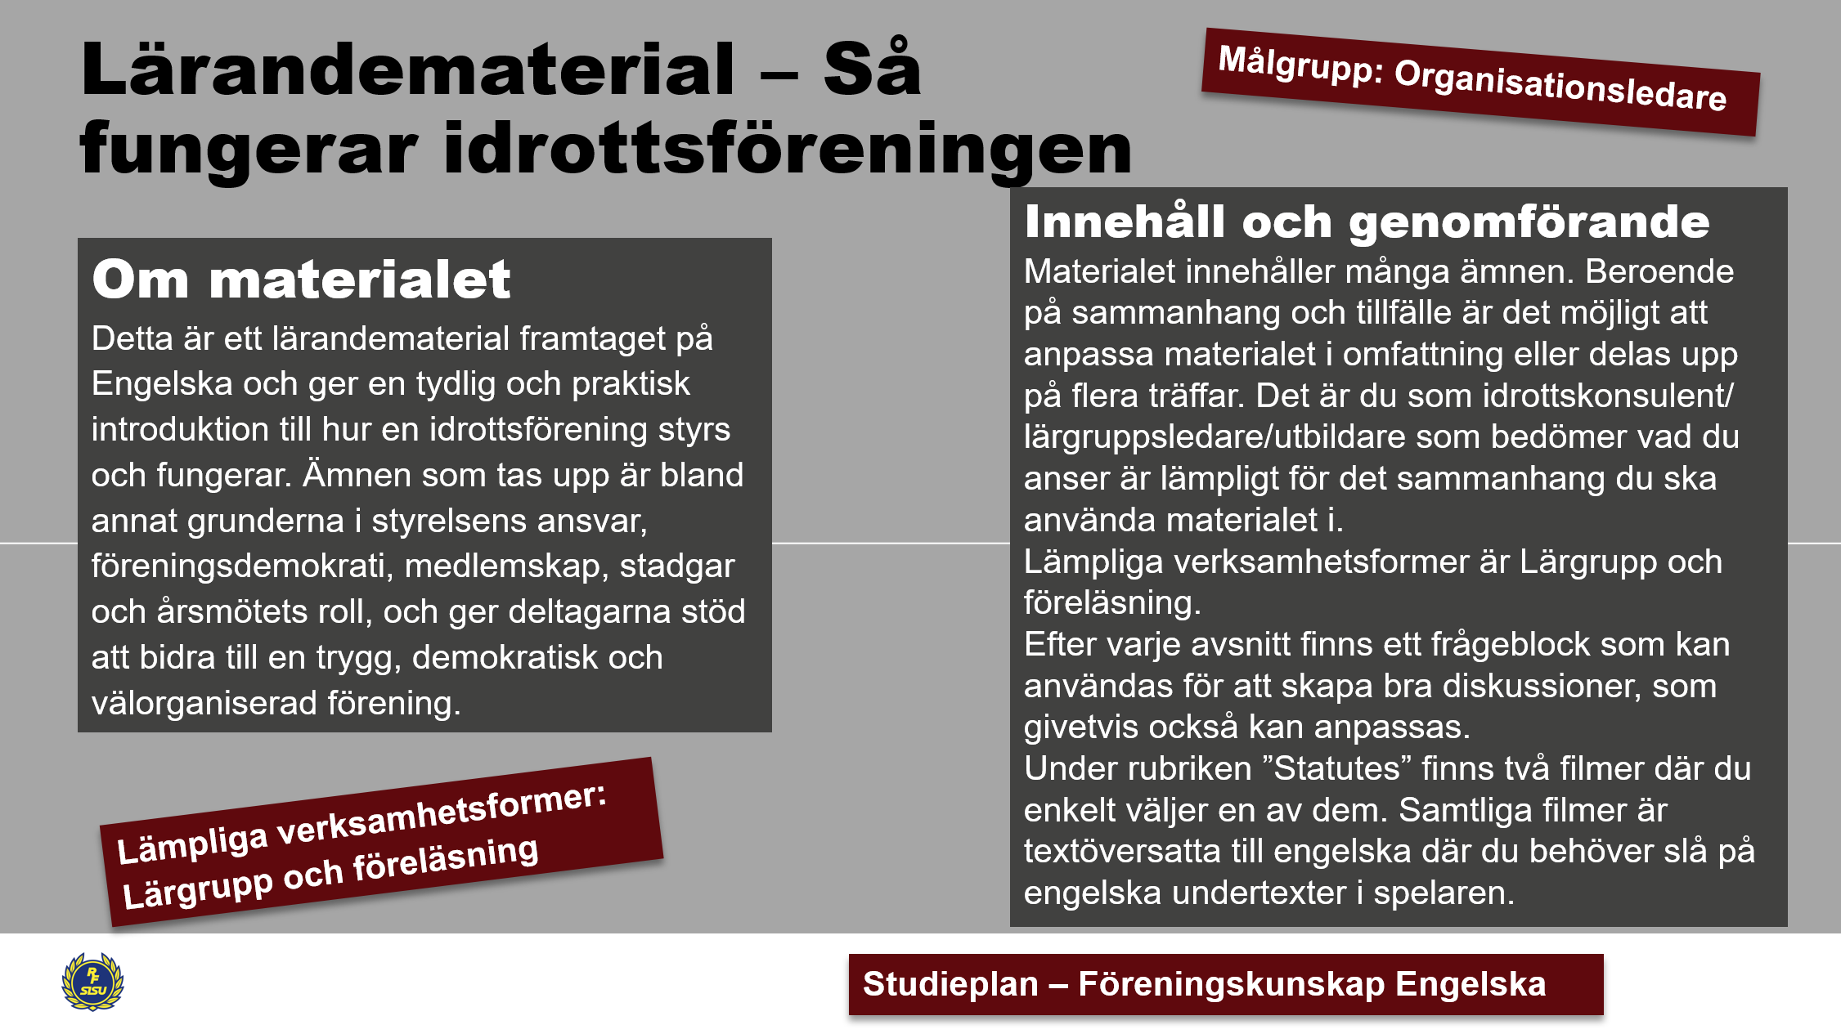

Slide 2
Ordlista
Förekommande engelska begrepp inom föreningskunskap
Annual meeting – Årsmöte
Auditor – Revisor
Auditor’s report – Revisionsberättelse
Balance sheet – Balansräkning
Board – Styrelse
Board meeting – Styrelsemöte
Cashier – Kassör
Chairperson – Ordförande
Commissioner – Ledamot med specifikt uppdrag
Constituting the board – Konstituering av styrelsen
Democracy – Demokrati
Discharge from liability – Ansvarsfrihet
District federation – Distriktsförbund
Financial report – Ekonomisk rapport
Fiscal year – Räkenskapsår
Legal person – Juridisk person
Sports club – Idrottsförening
LOK grant – Lokalt aktivitetsstöd
Member – Medlem
Membership fee – Medlemsavgift
Minutes – Protokoll
Motion – Medlemsförslag
Non‑profit association – Ideell förening
Nomination committee – Valberedning
Operational plan – Verksamhetsplan
RF (Swedish Sports Confederation) – Riksidrottsförbundet
RF‑SISU districts – RF‑SISU distrikt
Statutes – Stadgar
Secretary – Sekreterare
Signatory / Authorized signatory – Firmatecknare
Sports federation (SF) – Specialidrottsförbund
Term of office - Mandatperiod
Umbrella organisation – Paraplyorganisation
Voting list – Röstlängd
Vice chairperson – vice ordförande
Mer information och längre ordlista för internationell idrott hittar du på denna sida

Slide 3
How a sports club works
- Democracy, the board, the statutes and the members

Slide 4
The agenda
How to run the sports club
The board
The various association governing bodies
The non-profit association
The sports club and democracy
Member commitment
The statutes - a membership agreement
Annual meeting
The board’s mission
The board’s responsibility
Constituting the board
Different roles
Break with movement

Slide 5

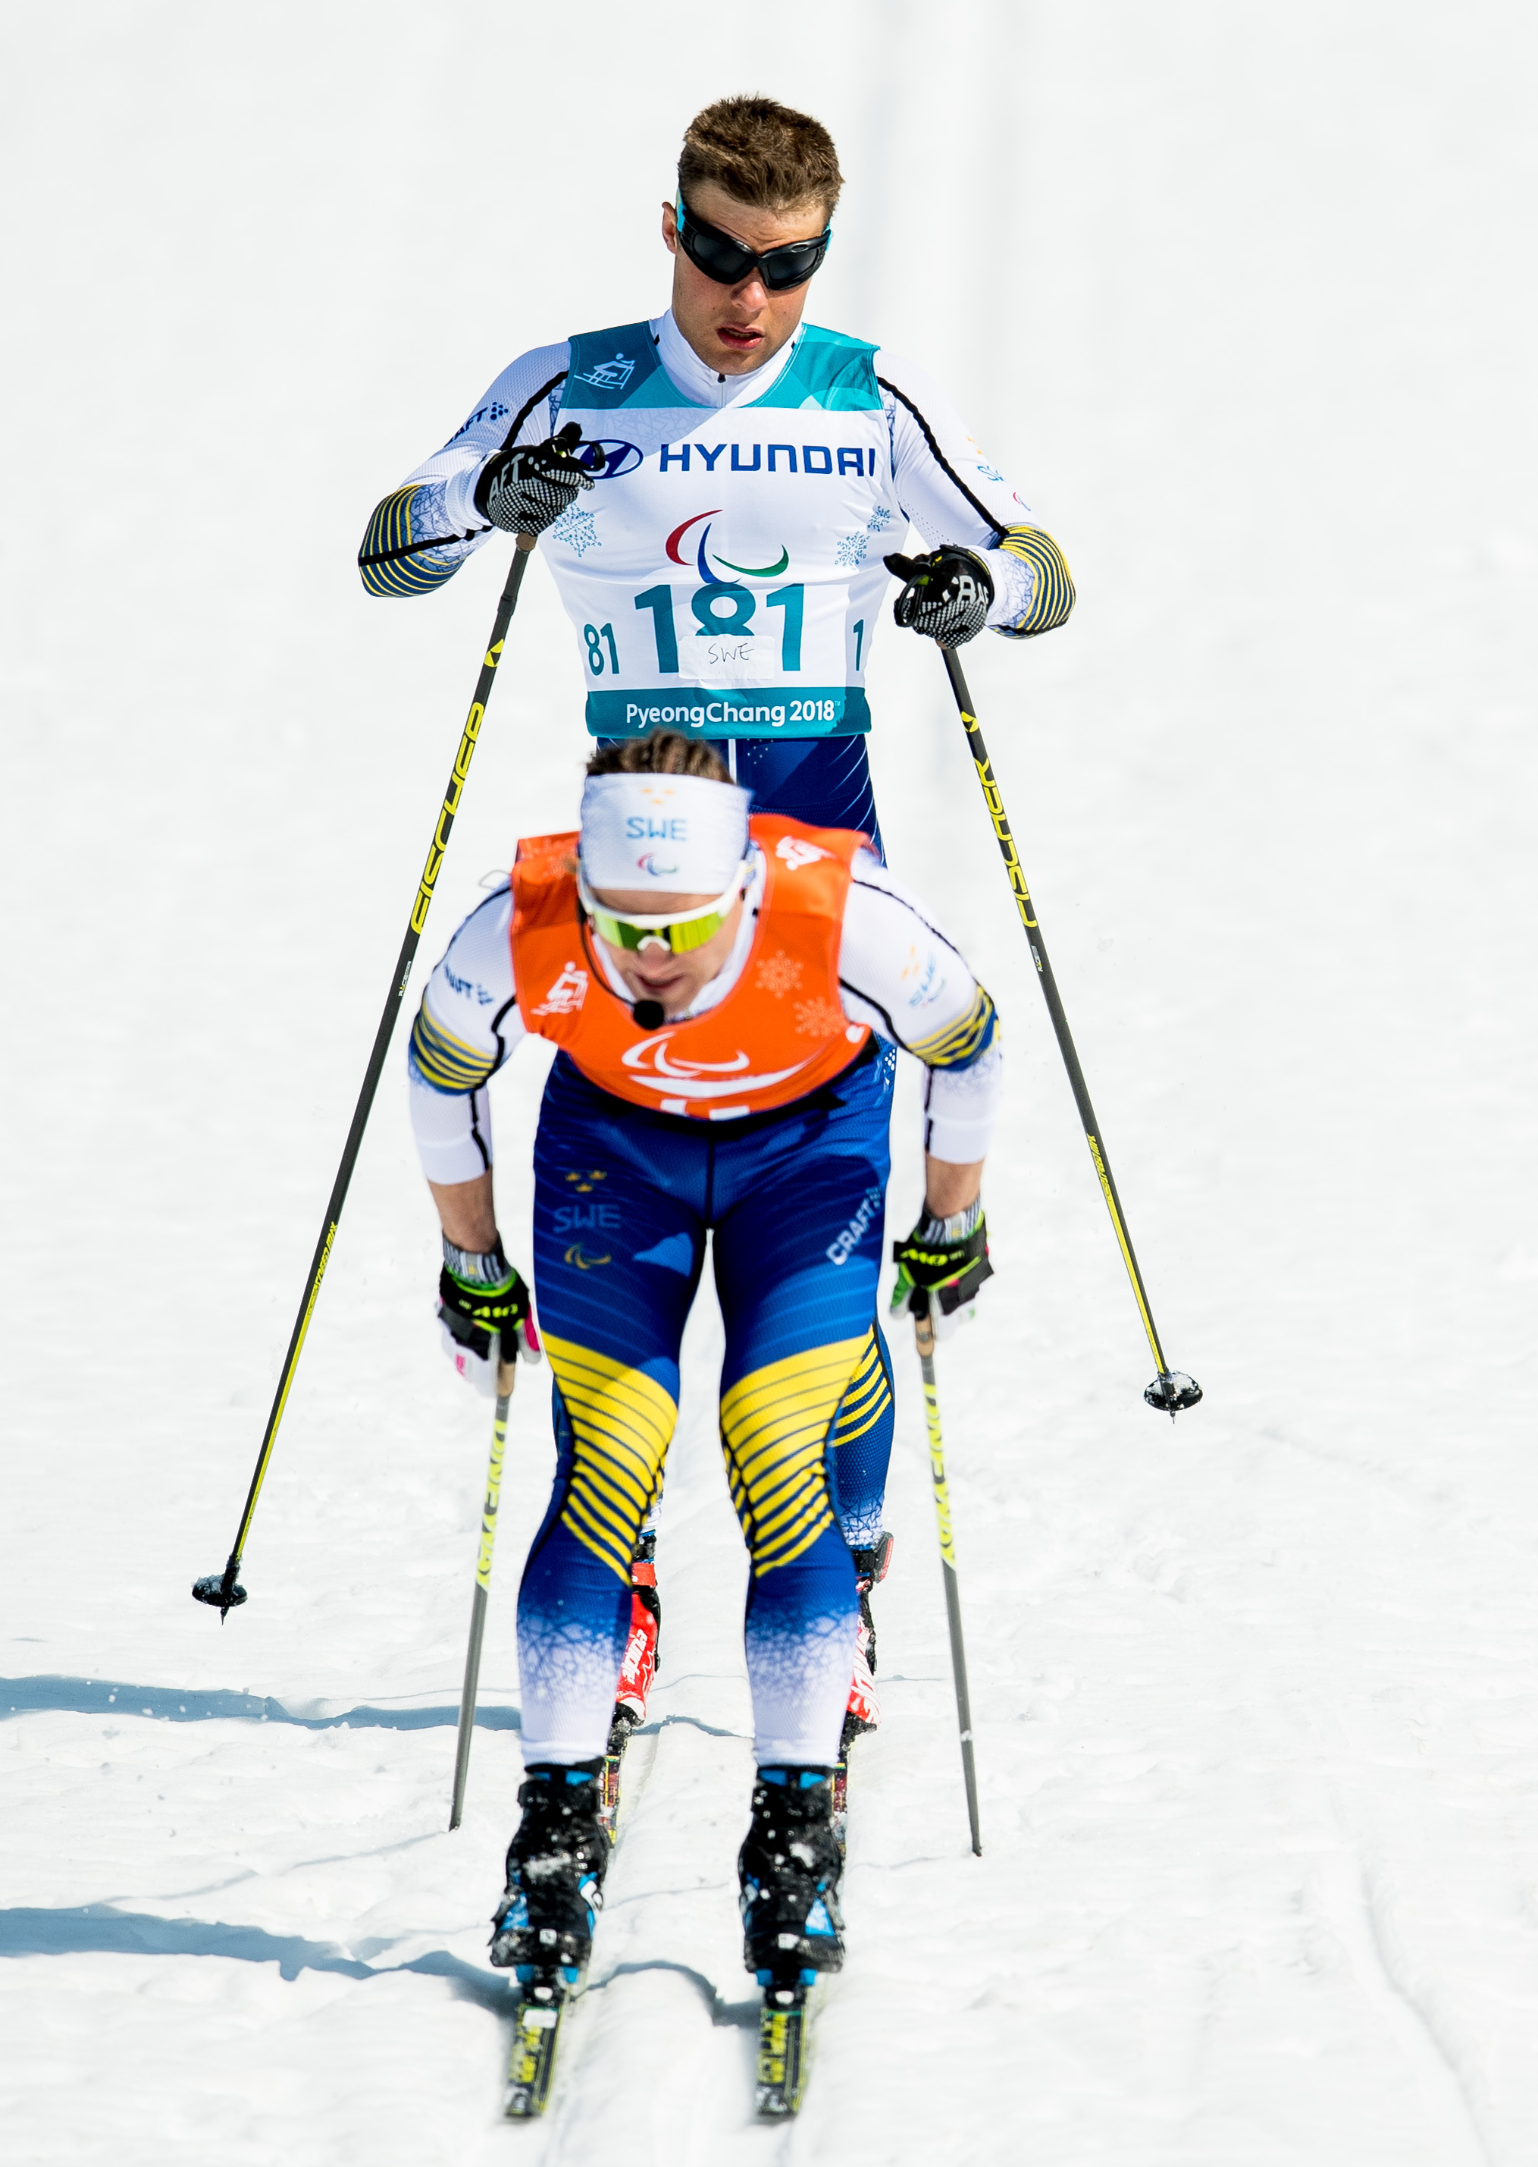
Round the table
Name?
Your role?
My best sporting memory

Slide 6


How we are organized
Swedish Olympic Committee
Swedish sports education
Swedish sports confederation
19 district federations
72
national sports federations
1 000
special
sports district federations
Membership
Regional organ
Administrative affiliation
18 000
sports clubs
3.1 million
members and athletes

Slide 7
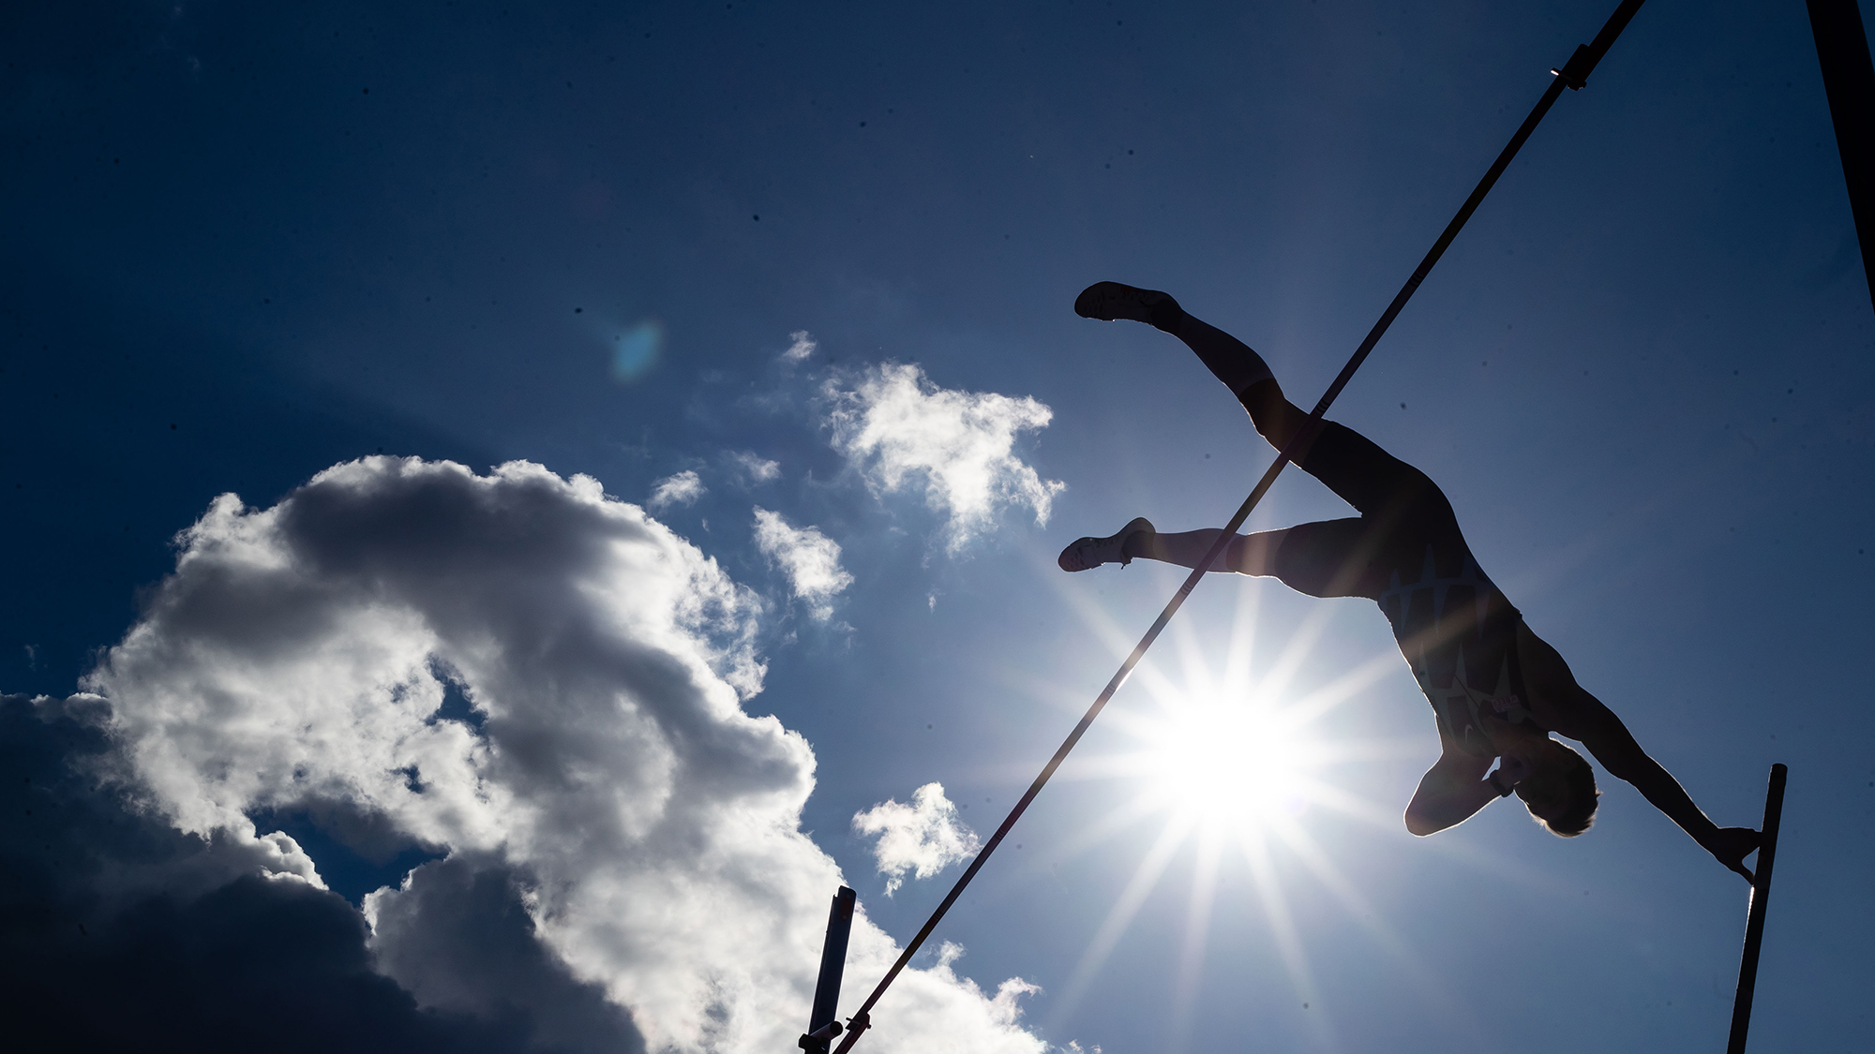
The Swedish sports confederation umbrella organisation for all organized sport
Notes:
Riksidrottsförbundet, the Swedish Sports Confederation, is an umbrella organisation for all organized sport.
RF serves as the central coordinating body of the Swedish sports movement.
RF supports, represents, leads and coordinates the sports movement regarding joint issues and shared concerns, domestically and globally.

Slide 8
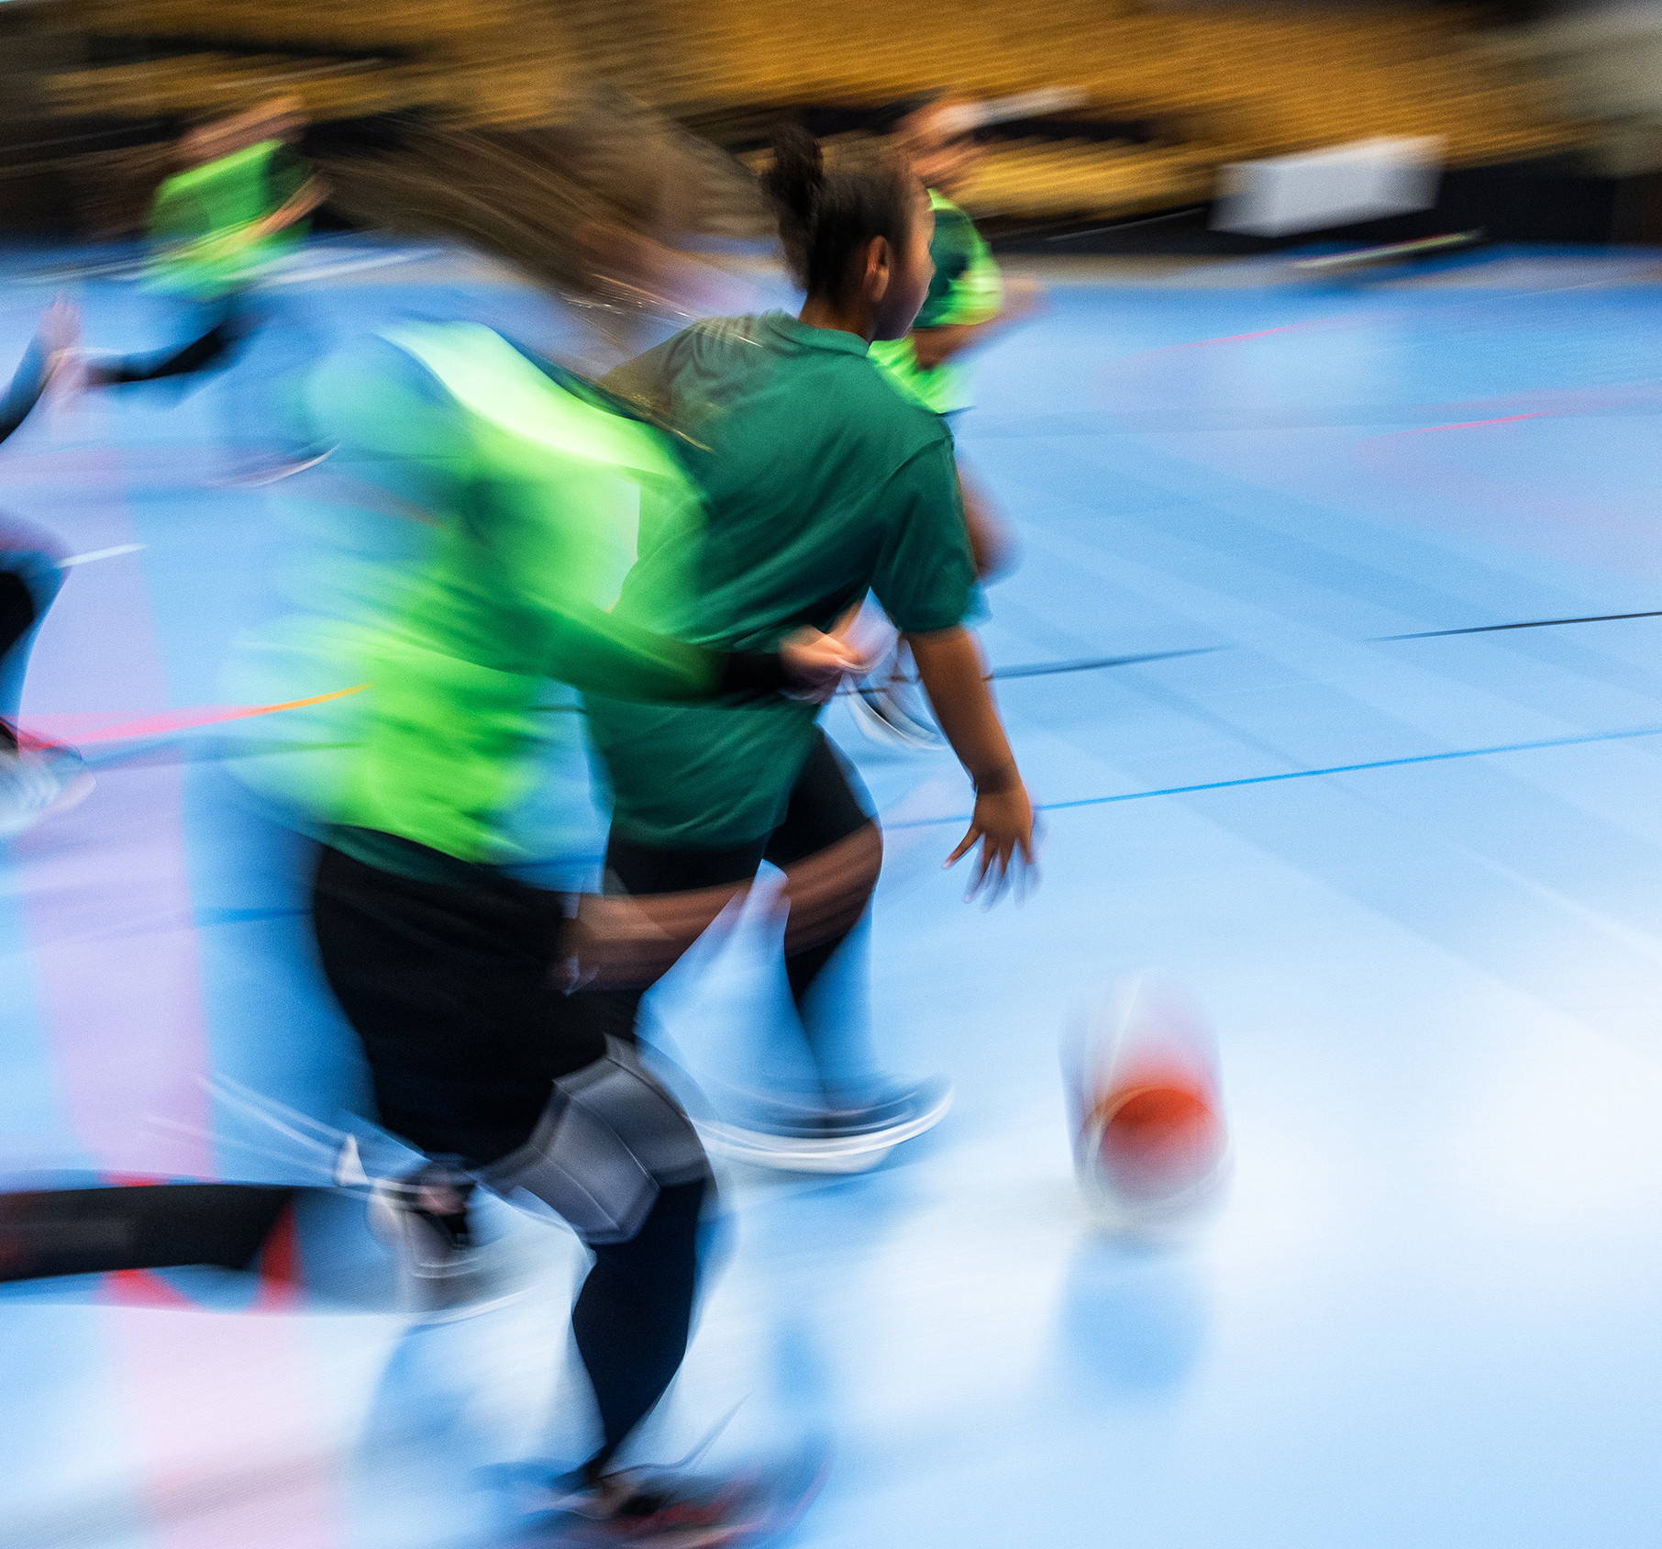
The Swedish Sports Confederation
Advocating towards the government – speaking on behalf of all member organisations.
Sport belongs to Ministry of Social Affairs where two persons are working with sport.
All tasks related to sport are handled by Riksidrottsförbundet.
Notes:
The Swedish Sports Confederation, Riksidrottsförbundet, plays a unique role. RF is the voice of 72 national sports federations, representing more than three million members. In Sweden, sport belongs to the Ministry of Social Affairs – yet only two civil servants work directly with sport. This means that almost all tasks related to policy, development, and advocacy are handled by RF, who works closely with government and society to secure the best possible conditions for clubs, leaders and athletes. The mission is clear: to make sure that sport continues to be open, democratic and a force that strengthens Sweden.

Slide 9
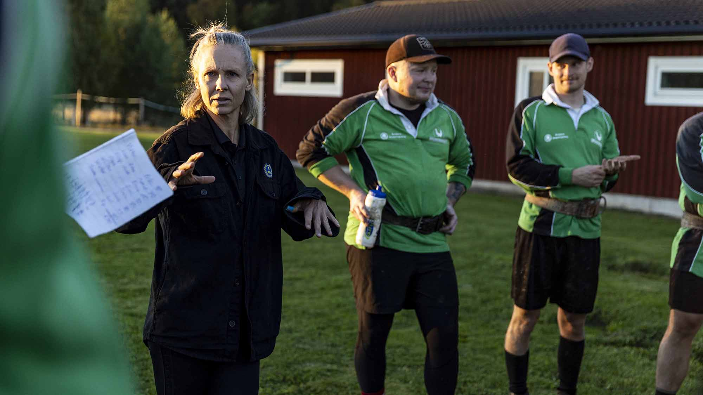

Swedish sports education
Lifelong learning and education
is essential for thriving sports
Notes:
Creating inclusive and high-quality sports environments—and achieving world-class standards—requires ongoing education, learning, and dialogue among coaches, leaders, parents, athletes, and elected representatives.
The Swedish Sports Education SISU Idrottsutbildarna provides vital support and tools that many clubs need to initiate development efforts and grow.

Slide 10
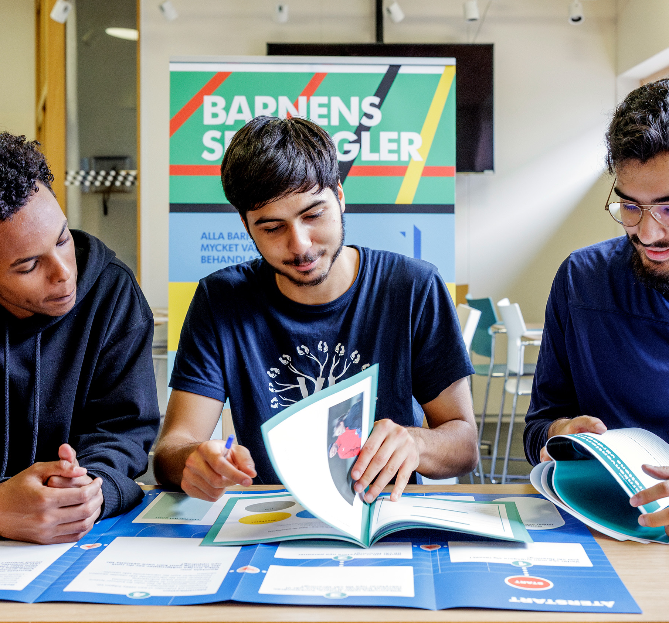
Swedish Sports Education 2025
Participants and participating club’s increased by 10 percent.
50 percent of the participants were younger than 25 years.
More than 500,000 individuals took part in non-formal education organized by a sports club.
9362 sports clubs were engaged in non-formal educational activities.
1.5 million hours of education.
Notes:
In 2024, the number of participants and clubs involved in the sports movement’s non-formal education – organized by SISU Idrottsutbildarna – increased by 11 percent.
Half of the participants were under the age of 25.
More than 500 000 individuals took part in non-formal education organized by sport clubs
8 883 sports clubs were engaged in educational activities
Almost 1,5 million (1 440 136) hours of education were carried out through study groups, courses, and process-oriented work.

Slide 11
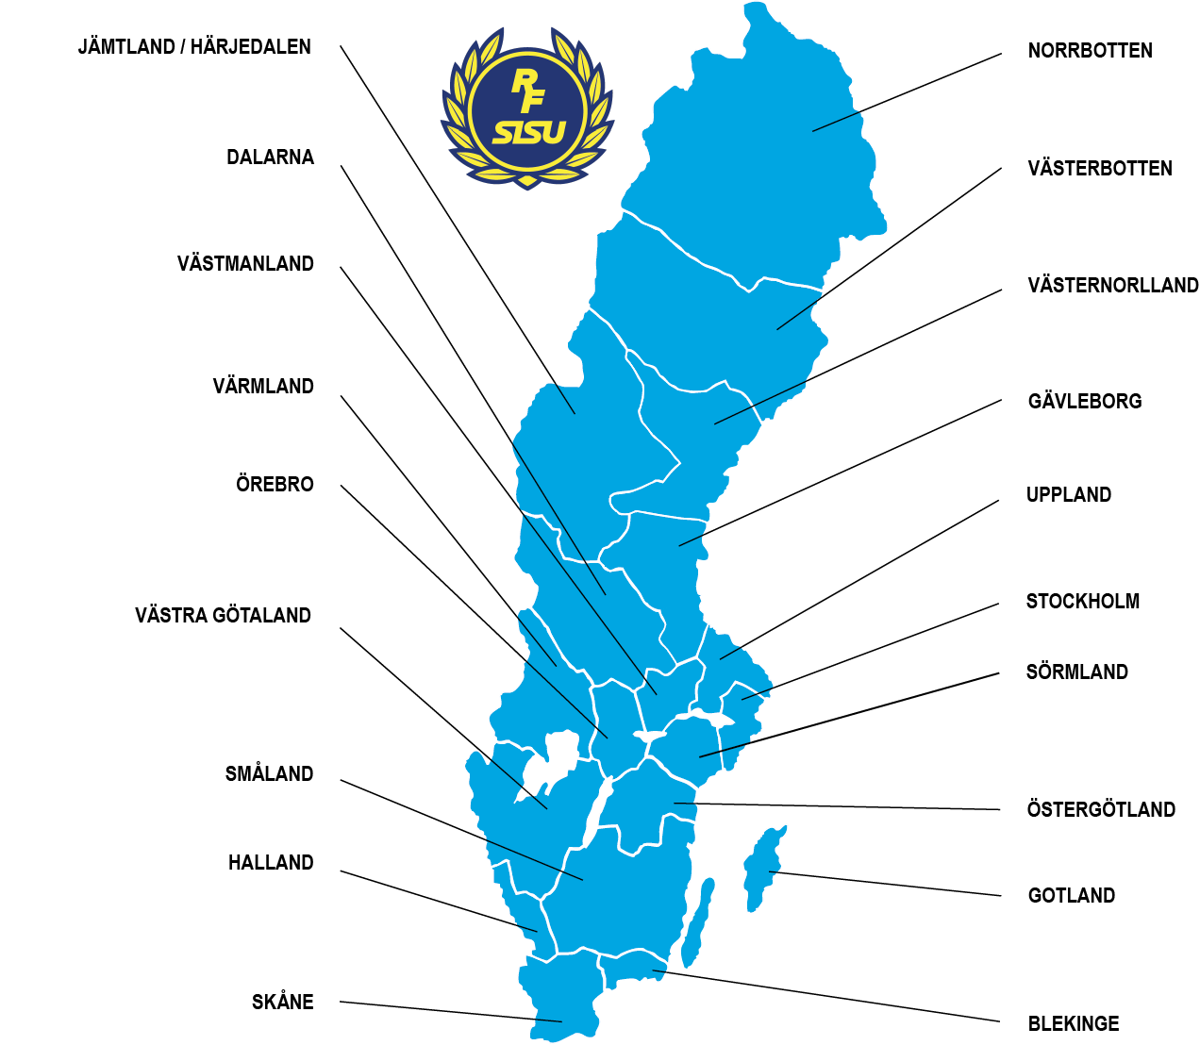
A strong
local presence
The RF-SISU districts supports, represents, leads, guides and educates the sports movement at regional level.
The 19 districts ensure a strong nationwide presence.
Notes:
The RF-SISU districts operate as regional organization of Riksidrottsförbundet and SISU Idrottsutbildarna. They play a key role in supporting, representing, guiding, and developing the sports movement regionally—through education, training, and shared values.
Thanks to the districts we can ensure a strong nationwide presence.
The RF-SISU districts:
- supports, represents and coordinates the sports activities organized by Riksidrottsförbundet, but on regional level.
- provides education and guidance to clubs in the region, helping them build and expand their organizational capacity. The staff at the RF-SISU districts work closely with the clubs, offering hands-on support and gaining deep insight into the everyday challenges they face. Through this direct engagement, they play a key role in strengthening the clubs’ activitites and development.

Slide 12

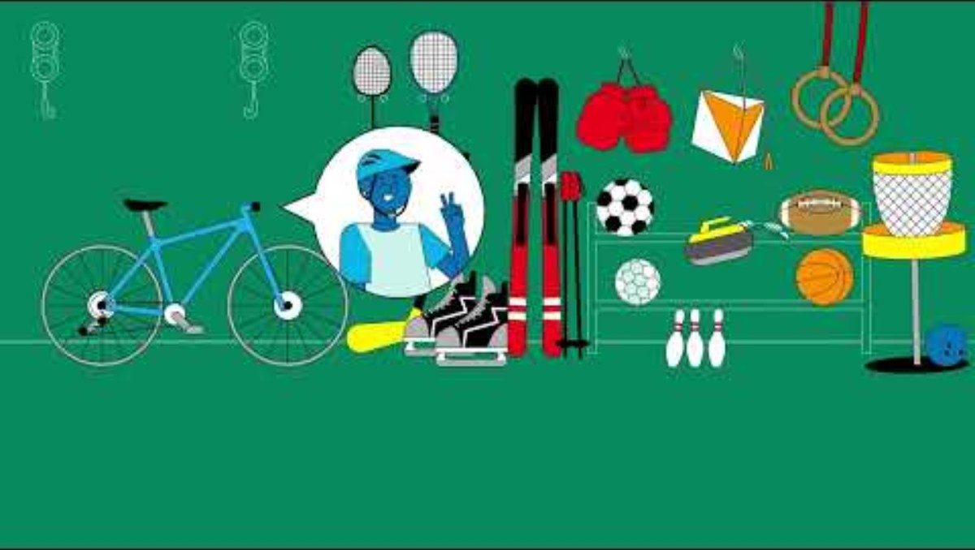
Sports – A great start in life
Notes:
Länk till filmen: https://youtu.be/YnOaLVm2CBg

Slide 13
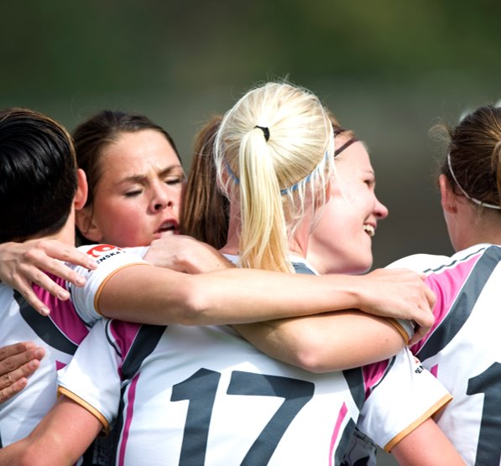

How to run the sports club

Slide 14
What is a non-profit association?
An organization is established by a group of people to pursue a common non-commercial purpose – social, cultural, sports or charitable – without distributing profits to its members. Any surplus is reinvested into the organization's activities to further its purpose and goals.
In Swedish: Ideell förening
In Swedish sports, the non-profit association model ensures that sports clubs are member-governed, community focused and democratically managed.

Slide 15
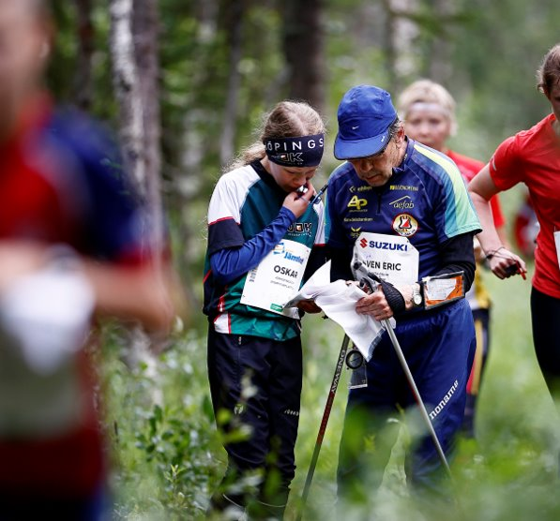

The members
=
The association
The association consists of the individuals who have been admitted as members.
No members = association

Slide 16

Non-profit Association Formalities
As no national law specifically regulates this issue, It is common to follow the law on economic associations and compare it for guidance. The sport clubs statutes and existing practice within organized sport provide the main guidance.
According to established practice, it is mandatory for a Club to have:
  Statutes of reasonable completeness.
  A Board (Executive committee) to be appointed by the members to represent the association.
  A name

Slide 17
A legal person
Can own property
May be a party to agreements
May be a party in court cases
May be a member of another non-profit association
Can be declared bankrupt
(försättas i konkurs)

Slide 18
Reflect together
In what ways do the statutes help create structure, fairness, and clarity within a sports club?
What are the most important elements that make a sports club democratic and member‑driven?
Why is it important for a sports club to be a non‑profit legal entity, and how does this affect the board’s responsibilities?
What challenges can arise when members are not fully aware of their rights, obligations, or influence within the club?
Notes:
Gruppindelning/grupprum ca 5-10 min

Slide 19
How to run the Sports club
Democracy

Slide 20
Democracy – basic knowledge
Sport Clubs consist of their members – and are open to all
are easy to establish (statutes, board and name)
are democratic organizations
are non-profit organizations – they cannot be owned
are ruled by members
are independent
can form sports federations (SF)
can choose to be member in SF
must follow rules within the membership of SF and RF

Slide 21
Chapter 1 RF´s statutes – The values of sports
Everyone has the right to participate
Fair play
Joy and community
Democracy and participation

Slide 22
Member´s rights
Being a member is voluntary
As a member, you have the right to participate in the sports club activities
Right to information
Right to be treated equally
Call for an extra annual meeting
Voting rights
Right to make proposals
Right to influence

Slide 23
Member´s obligations
Pay the membership fee
Follow collectively made decisions
You must be a member to compete for the association
You must follow the specified competition rules

Slide 24
Reflect together
What does it mean that a sports club is a democratic and member‑governed organization?
How does being open to all and non‑profit contribute to a democratic culture within the sports club?
In what ways can members influence decisions in the club, and how well do these opportunities work today?
Notes:
Gruppindelning/grupprum ca 5-10 min

Slide 25
How to run the sports club
Statutes

Slide 26

Statutes
”
Your club´s most important control instrument
”
”
”
An agreement between your sports club and its members
”
Your sports clubs book of law, useful in conflicts and to know how to make decisions
”

Slide 27
The statutes = the agreement between the members
How to become a member (Membership admission procedures)
How to exclude members
How the membership fee is determined
Board and auditors
How decisions should be made
Conducting the annual meeting
How to dissolve the association
How to change the statutes

Slide 28
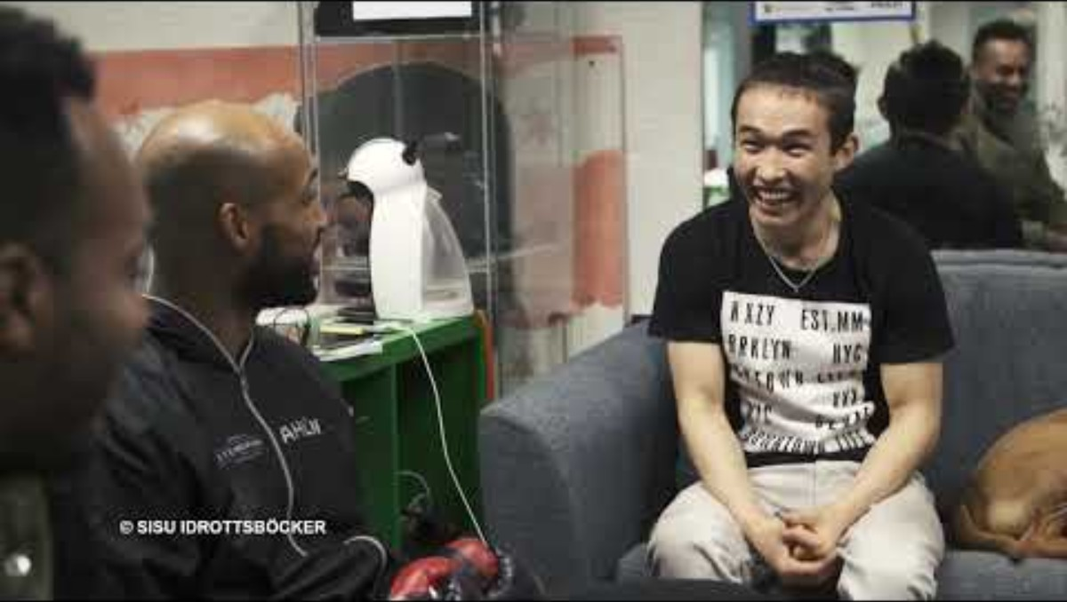
The purpose of statutes
Notes:
Länk till filmen: https://www.youtube.com/watch?v=GJxnL3VeQqo

Slide 29
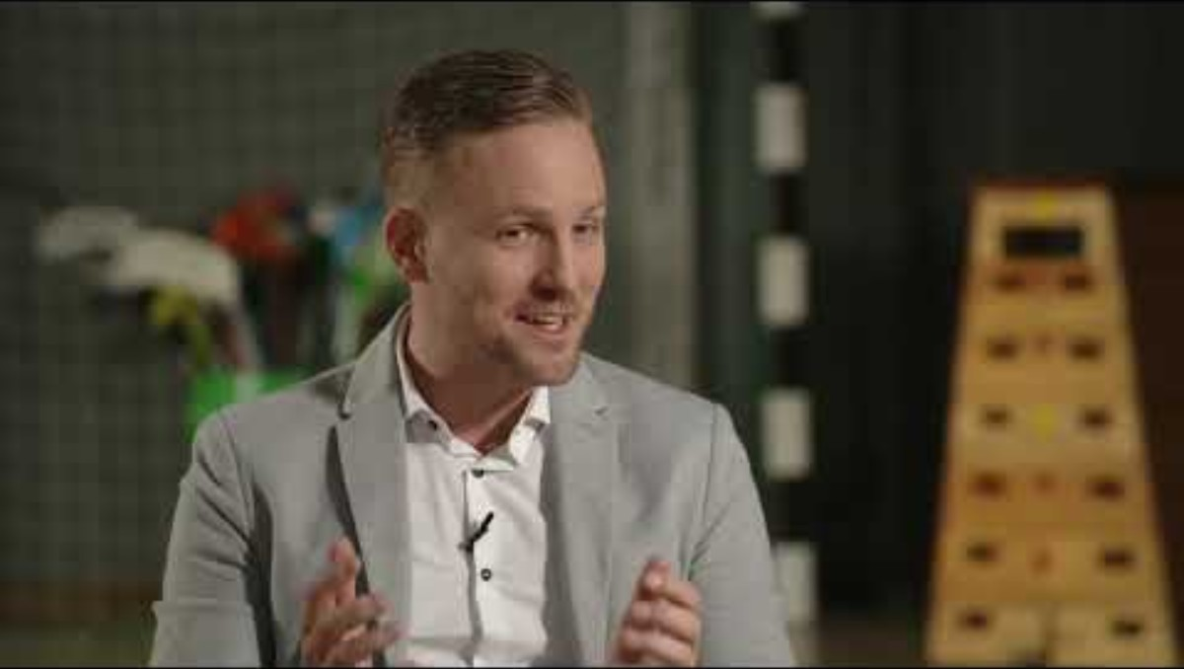
The purpose of statutes
Notes:
Länk till filmen: https://youtu.be/YnOaLVm2CBg

Slide 30
Reflect together
In what ways do the statutes function as an “agreement” between the club and its members?
How do the statutes help ensure transparency and fairness in decision‑making?
When is it necessary to update the statutes, and how do you know the right time has come?
Notes:
Gruppindelning/grupprum ca 5-10 min

Slide 31
How to run the sports club
Annual meeting

Slide 32
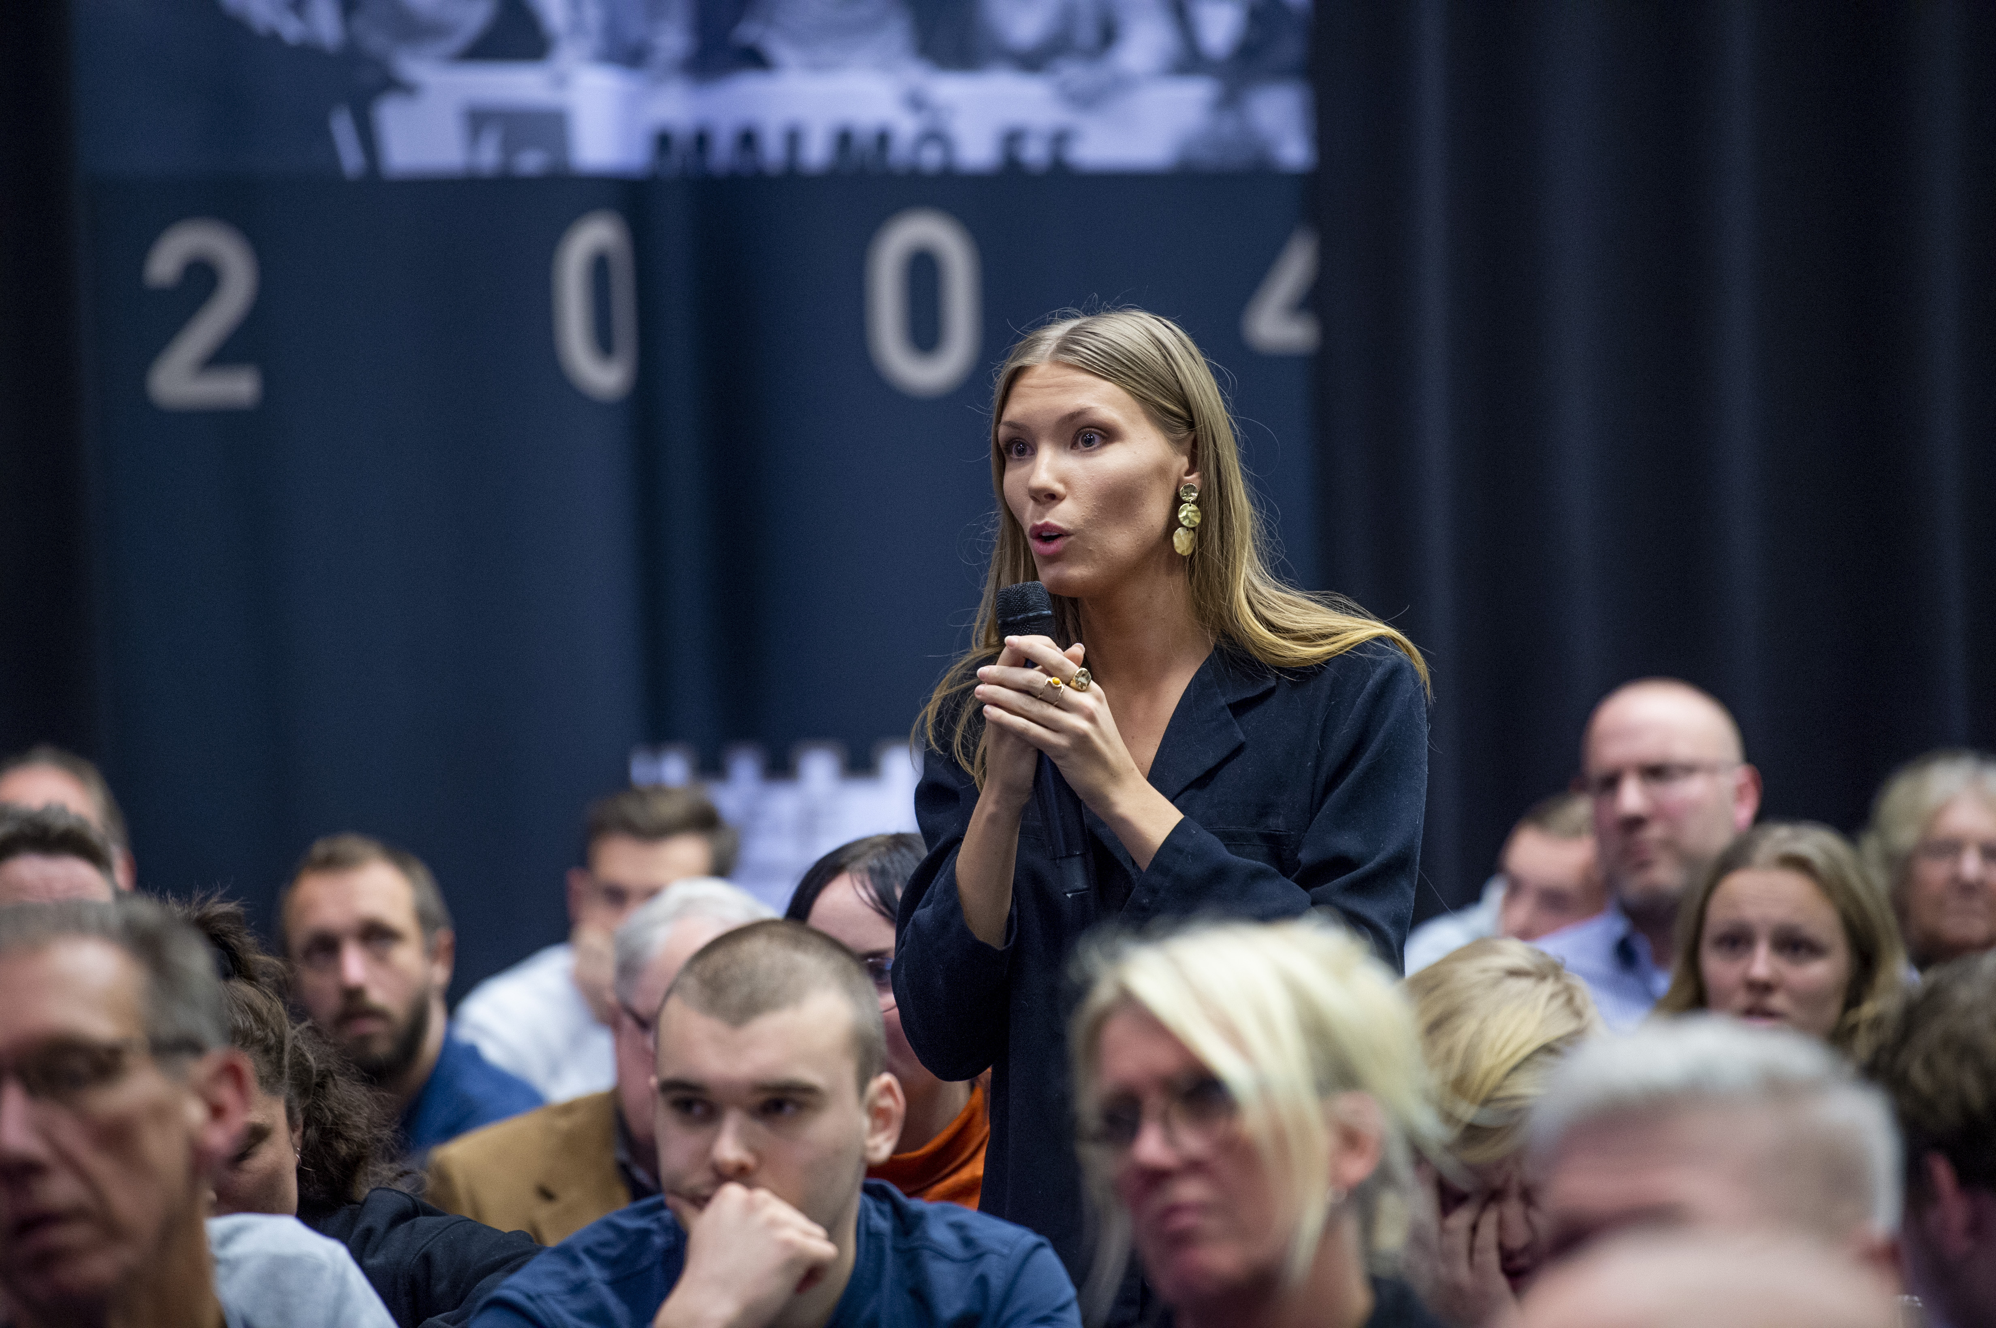
Annual meeting
At the end of the fiscal year, the Board presents its annual report and financial statements – including the income statement and balance sheet – to account for how it has fulfilled its responsibilities. These documents are then submitted to the annual meeting for review and approval
Explain the plans for the upcoming fiscal year by presenting the operational plan along with the projected costs outlined in the budget.
The members at the annual meeting…
… always have the ultimate decision-making power
…each member may submit motions proposing changes
…always have the opportunity to raise issues regarding conditions they are dissatisfied with
…change the composition of the board.

Slide 33
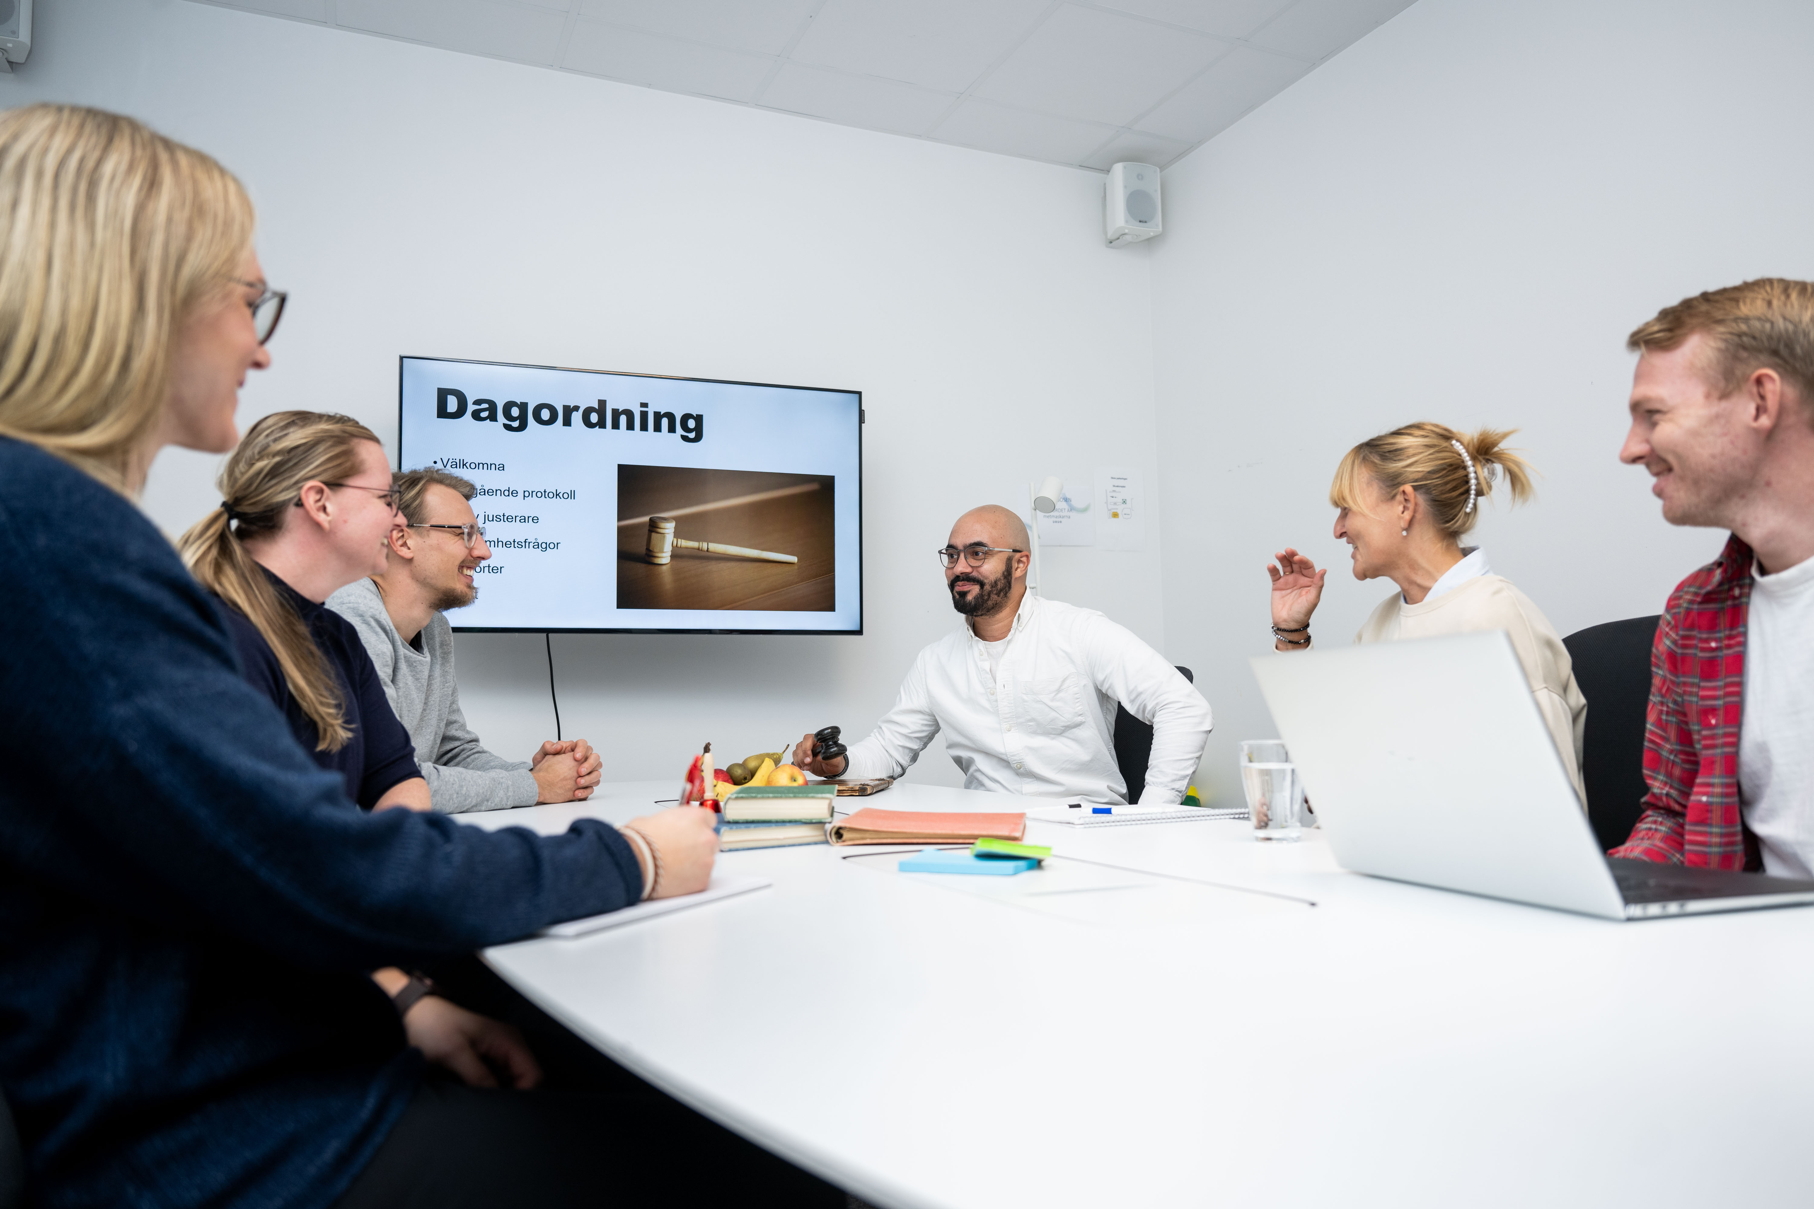
Annual meeting – 3 parts
Formalities for the meeting
Previous financial year
Upcoming financial year

Slide 34
Annual meeting
Formalities for the meeting
1. Determination of the voting list for the meeting
3. Election of adjuster of the minutes and vote-counters for the meeting
5. Approval of the agenda
2. Election of chairperson and secretary for the meeting
4. Ask if the meeting has been announced correctly

Slide 35
Annual meeting
Previous financial year
6. The Board's annual report for the past financial year
8. The auditors' report on the board's administration
7. The Board's financial report
9. Question about discharge from liability for the board

Slide 36
Annual meeting
Upcoming financial years
12. Consideration of the board's proposals and timely motions received
10. Determination of membership fees
14. Election of auditors
16. The meeting ends
11. Establishment of business plan and consideration of budget for the coming financial year.
13. Election of the association's chairperson and board members
15. Election of members to the Nomination Committee

Slide 37
Reflect together
How can the board prepare and present reports (annual report, financial statements, plans for next year) in a way that makes members understand why the meeting matters?
What practical actions could your sports club take to make the annual meeting feel meaningful, accessible, and important for all members?
Notes:
Gruppindelning/grupprum ca 5-10 min

Slide 38
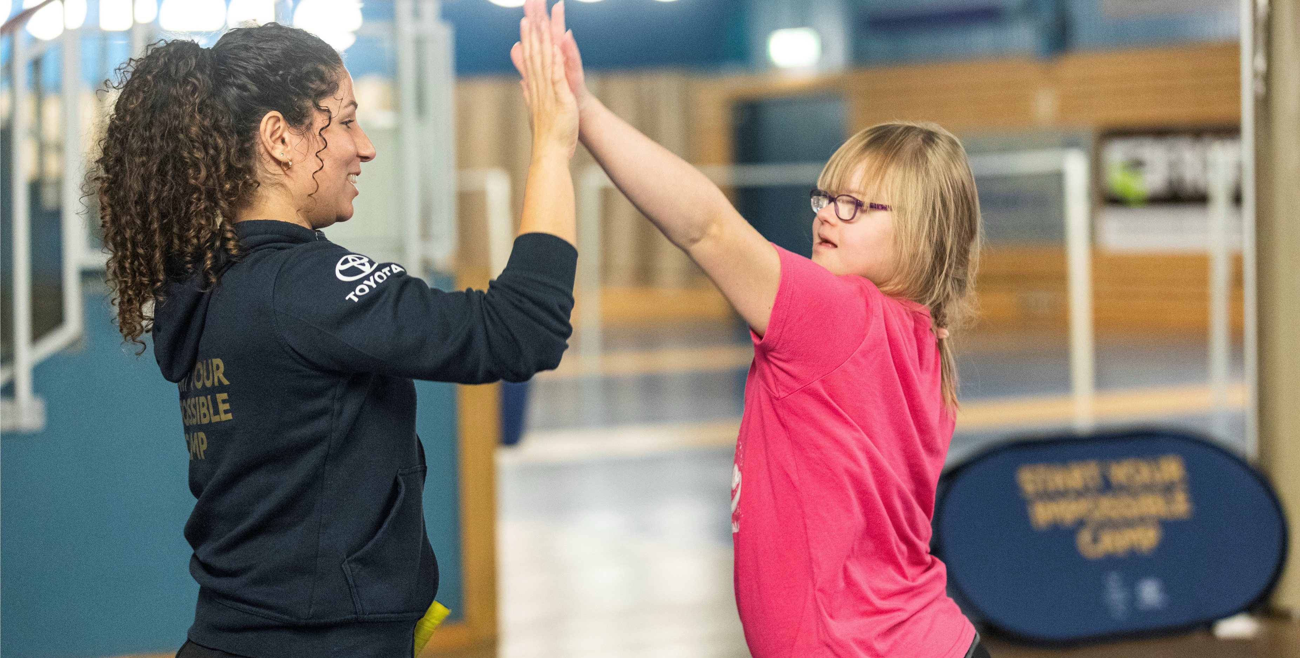
10 minutes break

Slide 39
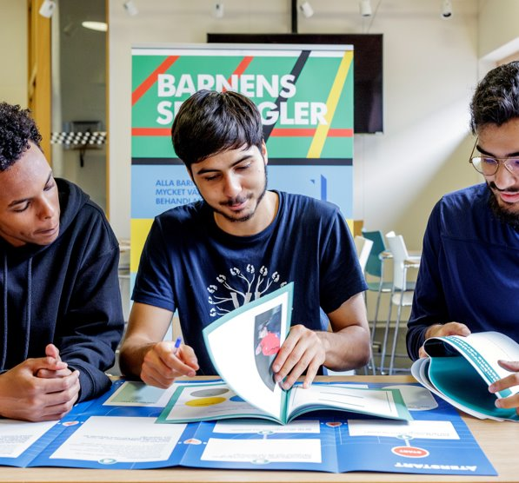
The board

Slide 40

Constituting the board
The first board meeting after the annual meeting
Who will serve as:
Vice chairperson
Cashier
Secretary
Education manager
Commissioner
More roles…

Slide 41
Constituting the board
Authorization to sign on behalf of the sports club
What is written in the statutes?
- Two members of the board together? Or
- Two members of the board separately
- Other examples…
- Sign contracts
- Proxy for the bank

Slide 42
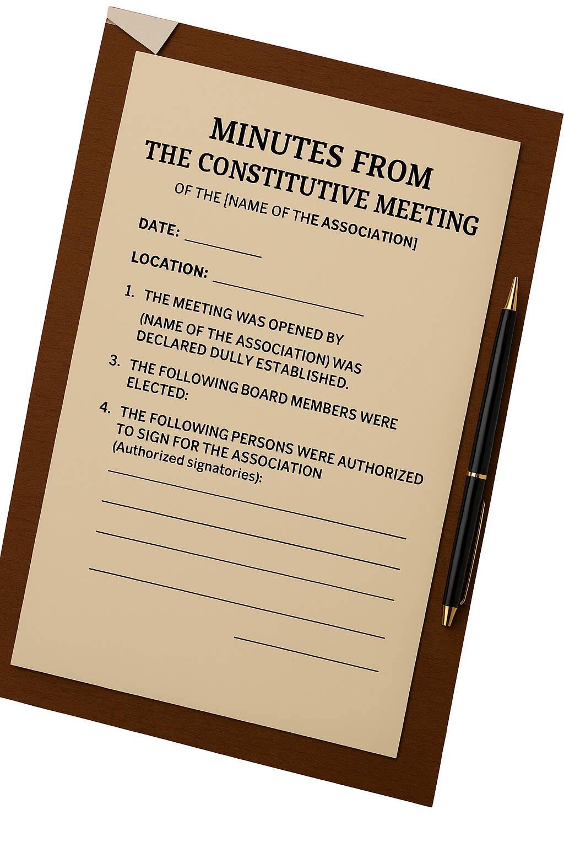
Constituting the board
Authorization to sign on behalf of the sports club
What is written in the statutes?
- Two members of the board together? Or
- Two members of the board separately
- Other examples…
- Sign contracts
- Proxy for the bank
Don´t forget to write your decisions in the minutes from the constitutive meeting!

Slide 43

The board´s responsibility
Following applicable laws and binding rules for the club
Implementing decisions made by the annual meeting
Planning, leading, and distributing the work within the club
Being responsible for monitoring the financial development of the club
Conducting budget follow-ups
Paying taxes and fees
Providing the auditors with accounts
Prepare the annual meeting

Slide 44
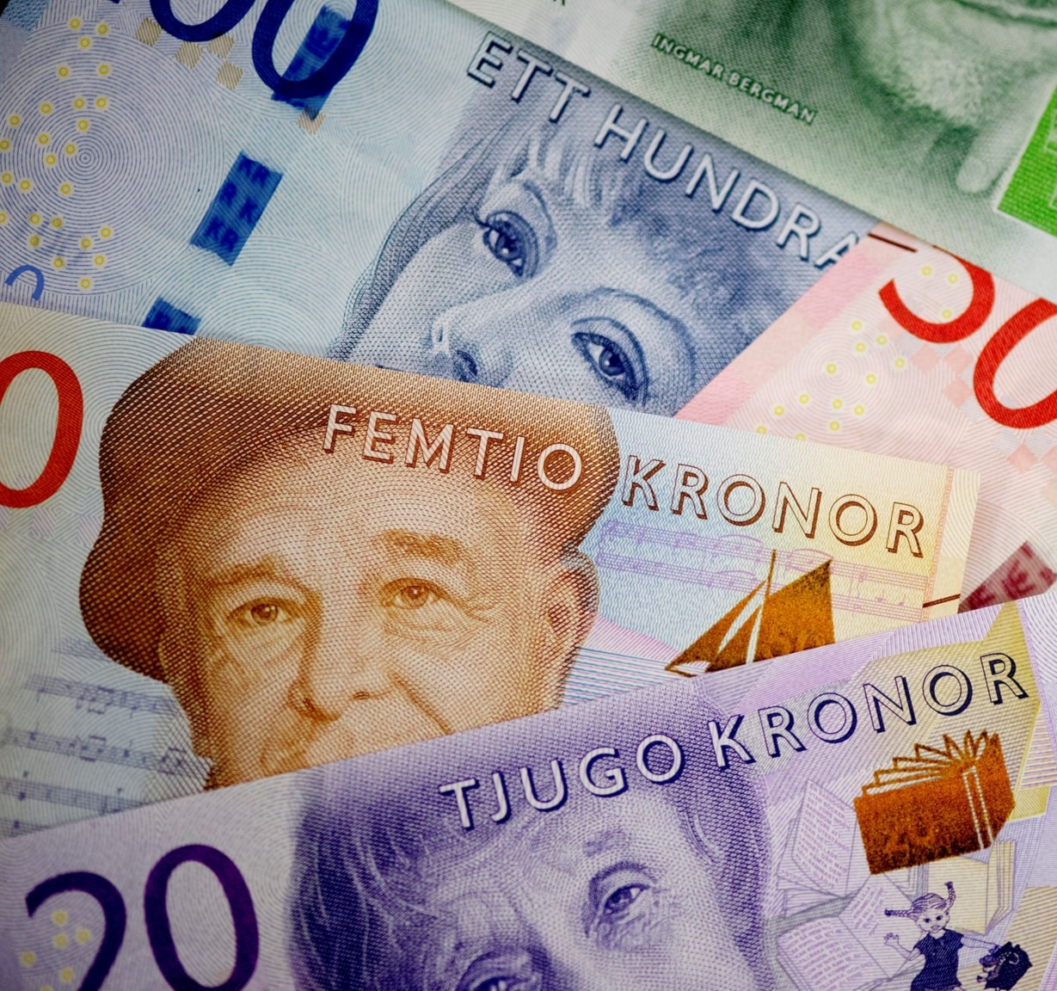
The board´s financial responsibility
Has joint responsibility for the clubs finances
Ensures that the club complies with laws and regulations
Monitors the financial development of the club
Follows the clubs finances on an ongoing basis
Ensure that taxes and fees are paid

Slide 45


Businessplan
Education plan for next year
Budget
Grant application
LOK
Board meeting
Board meeting
Annual report
Financial statements
January
September
October
November
December
August
Members meeting
Auditors report
February
Board meeting
Board meeting
Invite to annual meeting
3 weeks before, at least
Where
When
Where can members find the documents
Agenda
My boards year wheel
March
Annual meeting
April
Board meeting – to constitute the board
Board meeting
May
July
June
Board meeting
Grant application
LOK
Board meeting
Workshop with SISU

Slide 46
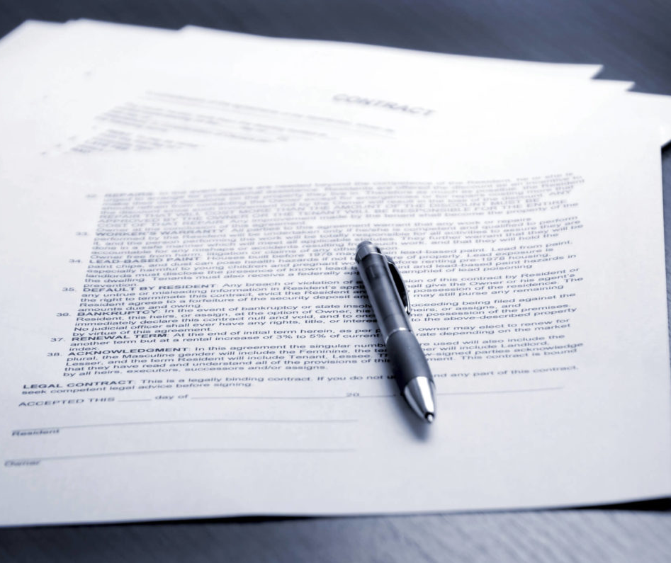
Board minutes
Discussion minutes
  - A brief summary of the discussion
Decision minutes
  - The key points of the decision should be clearly stated.
Approval of the minutes
Send to:
  - The board
  - Auditors

Slide 47
Reflect together
How can a board ensure that all members understand their roles — such as chairperson, treasurer, secretary — and that responsibilities are clearly distributed?
What routines or working methods help a board stay organized, well‑prepared and effective throughout the year?
What responsibilities of the board do you think are the most challenging for your association, and why?
Notes:
Gruppindelning/grupprum ca 5-10 min

Slide 48
Actionplan
What | Who | When
Information on FB about barbecueparty | Samuel | 1 June 2022
Invite nomination committee to board meeting | Sara | 10 June 2022
Contact SISU about education for parents | Nicole | 15 May 2022
Order footballs from Stadium | Samuel | 31 May 2022
What should be done?
Who is responsible?
When should it be ready?

Slide 49
The board
Different roles

Slide 50
To be chairman
Always takes more time than you think!
Requires great commitment
Responsible for the board pursuing the right issues
Must be well acquainted with the sports club activities
Leads the work and sets the "mood" in the boardroom
must be able to delegate. It is not a "one-man show“
Seeks “if possible” consensus on decision issues. . . BUT a decision must be made

Slide 51
To be cashier
Responsible for the overall financial tasks
Handles current invoicing
Handles current payments
Ensures that all payments are certified by a qualified person
Keep an up-to-dated list of members
Responsible for reports to board meetings

Slide 52
To be secretary
Takes care of the ongoing mail handling
Sends summons and agenda to meetings
Traditionally, the task is to keep notes and write minutes of board and annual meetings
Responsible for archiving minutes of board and letters

Slide 53
The auditor
How has the board handled the association's money?
Are there routines for reporting membership fees
and lotteries?
Are taxes and fees paid?
That the financial statements have been prepared
correctly
Is control information submitted?
Does the board's administration comply with
the sports club statutes, purposes and annual
meeting resolutions?
Have the board’s decisions been formally correct?

Slide 54
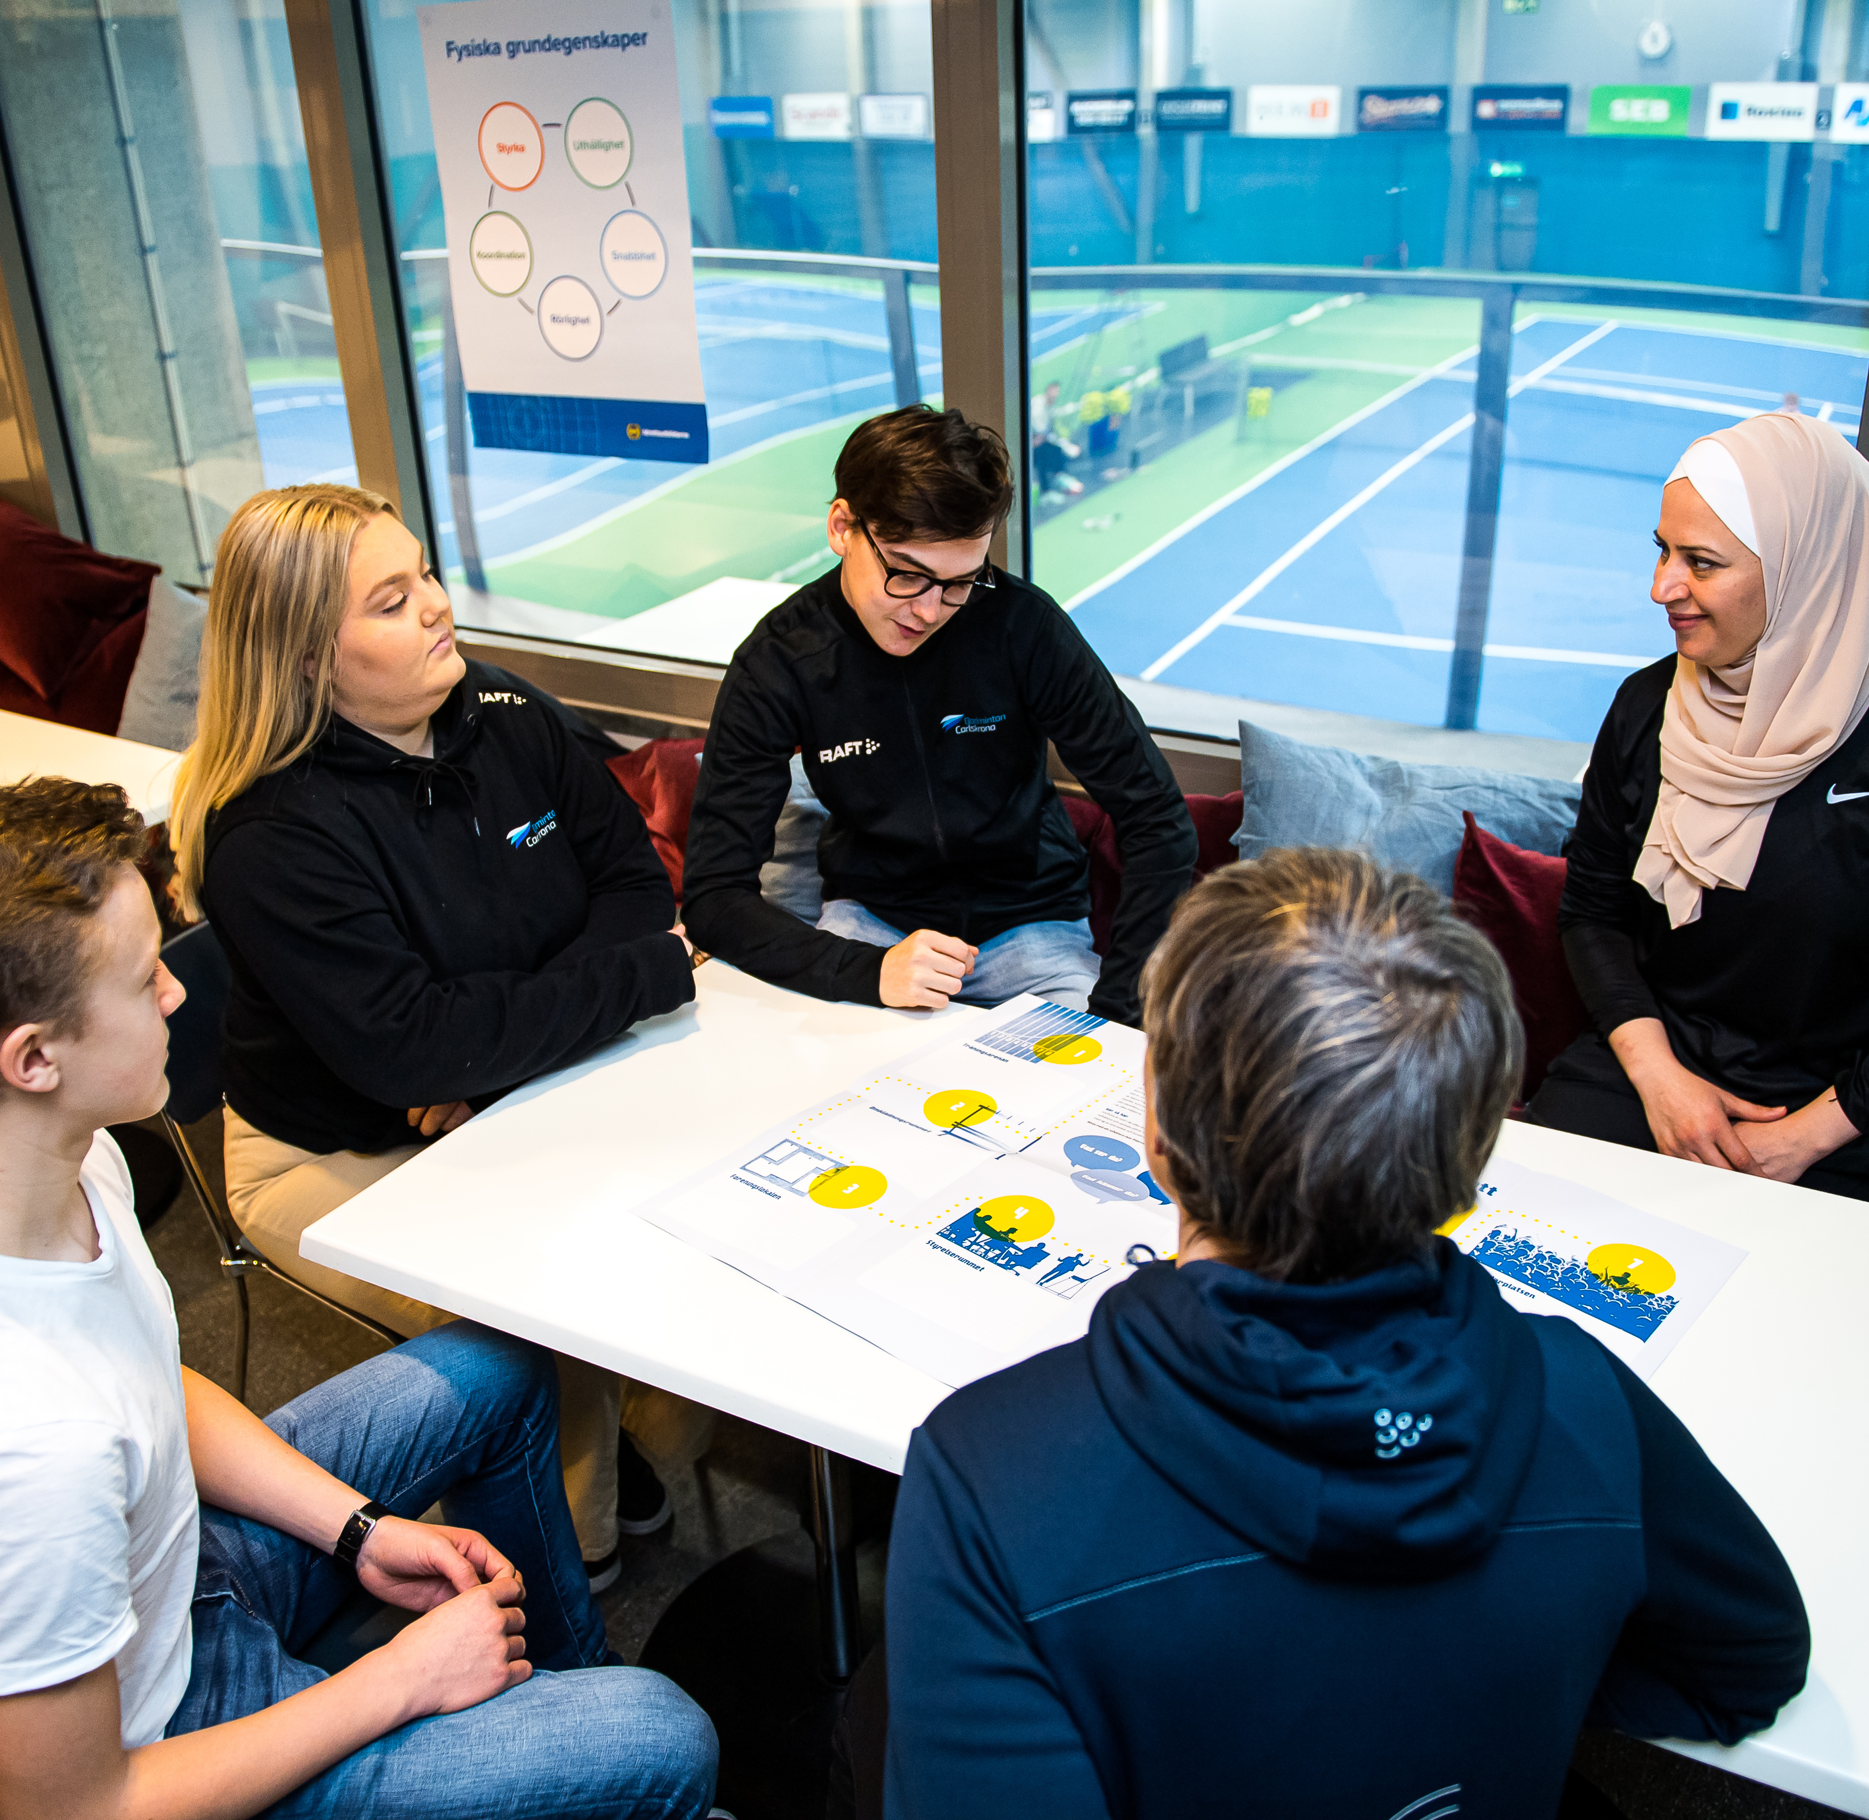
Involve more members
It is important to involve more people in the business.
Competence development is important for both the board, leaders and coaches
Invite potential board members to any board meetings
Information and communication are super important
Don’t hesitate to ask parents

Slide 55
Out standards for productive board work
We receive documents and agendas in good time before the board meeting
We always come well prepared for the board meeting
We have the right discussion topics on the agenda
We turn off cell phones when the meeting begins
We work efficiently and methodically on the board
Everyone has a clear role and feels confident about what to contribute
Everyone has space to express themselves and contribute to the conversation during the meeting
Our board meetings are kept to an appropriate length

Slide 56
Reflect together
How can the board ensure that all roles are clearly defined and that each board member feels confident and supported in carrying out their tasks—especially new or inexperienced members?
How can the board work to build strong collaboration—ensuring that board members communicate well, understand each other's roles, and create a positive and effective working environment throughout the year?
Notes:
Gruppindelning/grupprum ca 5-10 min

Slide 57


Contact
Your Name
Title
Email
Phone number
Your Name
Title
Email
Phone number

Slide 58
Thanks for today

